Slide 1



PICTURES TOPIC CLASSIFICATION (DL)
AL-BARAA IBRAHIM MELHEM

Slide 2
TABLE OF CONTENTS
01
02
03
04
05
INTRODUCTION
IMPORTANCE
LIBRARIES
DATA
NLP
06
AI MODEL

Slide 3


01
INTRODUCTION

Slide 4

INTRODUCTION
Science is always advancing, with the current trend
leaning towards automating daily tasks and relying
more on machines. While it's hard to imagine
completely replacing human roles, there's a positive
movement to elevate human competition against
machines. In this project, we're focused on
developing an artificial intelligence model that can
identify topics from text within images and
categorize them based
on content.
It's important to note that the project might have
some issues, and the model's accuracy might not
be perfect right now.

Slide 5
However, from these challenges and opportunities,
new ideas can emerge. The development journey
encourages growth and creativity. In this evolving
landscape, there's also room to enhance the model
to distinguish more categories. Moreover, we can
explore models that predict topic details and link
them to real-world problems.
I hope the model meets your expectations, and I
look forward to your feedback after reviewing it.
Thank you.

Slide 6
—Nelson Mandela
“Do not judge me by my successes; judge me by how many times I fell down and got back up again.

Slide 7
02
IMPORTANCE

Slide 8
IMPORTANCE OF USING AI IN TEXT CLASSIFICATION
Scalability and Efficiency: Instead of slow and error-prone manual sorting, machine learning can quickly and cost-effectively analyze large amounts of text like surveys, comments, and emails.
Reliable Consistency: Unlike humans who can introduce errors due to distractions, fatigue, and biases, machine learning maintains uniform standards for classifying text. A well-trained model consistently provides accurate results.

Slide 9
In general, artificial intelligence
saves companies a lot of effort,
money, and time in text
classification, with higher
efficiency than humans who are
susceptible to various
distractions, work interruptions,
faults, and other issues.

Slide 10
03
LIBRARIES

Slide 11
LIBRARIES USED
pandas | For data manipulation and analysis
os | For interacting with the operating system
tqdm | To create progress bars for loops to track the progress of operations
neattext | For text processing library used for text cleaning and normalization
nltk | The Natural Language Toolkit, used for NLP operations.
spacy | NLP library used for text processing tasks, including POS tagging
re | For pattern matching and replacement in strings

Slide 12
WordNetLemmatizer | For lemmatization
wordnet | To access WordNet's POS tags for lemmatization
sklearn | To prepare the data for model training
LabelEncoder | To encode label values
shuffle | To shuffle DataFrame rows
Tokenizer | For tokenization
pad_sequences | Pad sequences to a consistent length

Slide 13
Embedding, LSTM, Dense, Dropout, Sequential | For building the neural network model
to_categorical | Binary matrix representation of the input as a NumPy array
pickle | For saving and loading the tokenizer
pytesseract | to extract text from images using OCR
cv2 | for image processing
numpy | for numerical operations and array handling

Slide 14
04
DATA

Slide 15
DATA
TOPICS
21%
27%
27%
I collected data from multiple sources on Kaggle and compiled it into a single dataset to work with.
Emotion
Health
Politics
3.5%
4.5%
17%
Science
Sport
Financial

Slide 16
DATA PROCESSING
CLEANING
MERGING
COLLECTING
CLASSIFYING

Slide 17
05
NLP

Slide 18
NLP PIPELINE
text
Text
cleaning
POS
tagging
lemmatization
Clean
text

Slide 19
06
AI MODEL

Slide 20
MODEL
The model was trained using 80% of the available data. During training, the sequences were limited to a maximum length of 20 words to manage input size. The model architecture comprises four essential layers:
Embedding Layer: This layer transforms the input word indices into dense vectors, allowing the model to learn contextual relationships between words.
LSTM Layer: Utilizing Long Short-Term Memory units, this layer captures sequential patterns and dependencies within the input sequences.
Dropout Layer: To mitigate overfitting, a dropout layer was included, which randomly deactivates a portion of the LSTM units during training, thus enhancing generalization.
Dense Layer: The final layer applies a softmax activation function, facilitating multi-class classification. The ‘softmax' activation transforms model outputs into probability distributions across classes.

Slide 21
MODEL
The chosen loss function for optimization is ‘categorical_crossentropy,' an appropriate choice for multi-class classification tasks. The model's optimization is managed by the ‘adam' optimizer, known for its efficiency and adaptability. During training, accuracy is utilized as the primary evaluation metric, providing insight into the model's performance.
The training process is tuned with a batch size of 25, indicating how many samples are used for each update of the model's internal parameters. Training is conducted over 5 epochs, which signifies the number of times the entire dataset is presented to the model during training.

Slide 22
MODEL
Image Text Extraction and NLP Analysis
Topic Prediction
MODEL Experiment

Slide 23

Image Text Extraction and NLP Analysis
We employed `pytesseract`, a Python wrapper for Google's Tesseract-OCR Engine, to seamlessly extract textual content from images. Tesseract, renowned for its open-source nature, is a robust optical character recognition (OCR) engine.
A custom-made class, created based on principles similar to those used in previous natural language processing (NLP) tasks, is referred to as a ‘text_cleaner' class. This class efficiently manages tasks like cleaning up text, reducing words to their basic forms (lemmatization), and identifying the types of words (part-of-speech tagging) in the extracted text.

Slide 24

Topic Prediction
Turning Text into Numbers: We have a way to convert our cleaned-up text into numbers.
Setting a Limit: We decide how long we want these numbers to be.
Getting Ready for Prediction: Now, we're ready to use our model. We put these prepared numbers into our model, and it tells us how likely the text belongs to different categories.
Making the Final Call: We find out which category has the highest chance based on the numbers our model gave us. This category is like the best guess for what the text is talking about.
Labeling the Topic:.' Depending on the highest chance we got from our model, we decide which topic the text fits best.
Printing the Result

Slide 25

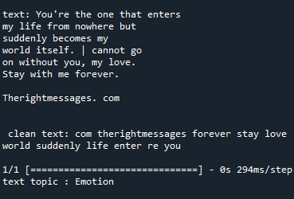
MODEL Experiment
You can replace the image on the screen with your own work. Just right-click on it and select “Replace image”

Slide 26

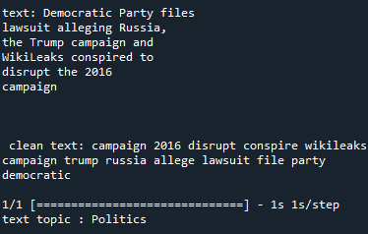
MODEL Experiment
You can replace the image on the screen with your own work. Just right-click on it and select “Replace image”

Slide 27
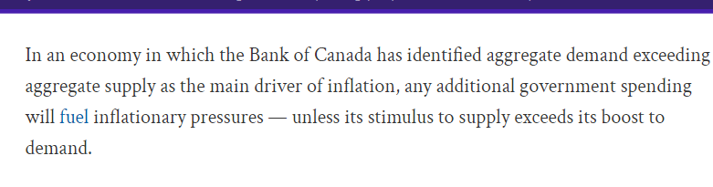
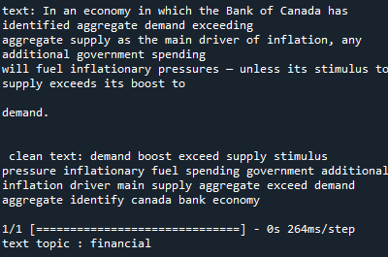
MODEL Experiment

Slide 28

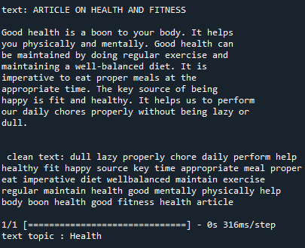
MODEL Experiment

Slide 29
Evolutionary Vision
Envisioning the Future of Our Model: As you've noticed, our current model, while not overly complex, shows promise for improvement. Our journey ahead involves elevating this model to new heights.

Slide 30
Firstly, we aim to broaden the scope of our model's capabilities. Expanding beyond the existing topics, we're determined to incorporate additional subjects, making it even more versatile and insightful. This will empower our model to offer insights and categorizations across a wide array of domains.
Secondly, our goal is specialization. We're diligently working to refine our model's abilities, enabling it not only to classify topics but to understand the nuances and intricacies of each topic itself. This advancement will open doors to various industries and applications, establishing our model as a valuable asset in numerous fields.

Slide 31
Furthermore, we're dedicated to enhancing the model's user experience. We're developing a user-friendly interface that empowers users to effortlessly explore and interact with images. By providing expanded options, we're ensuring that users have greater control and flexibility in utilizing our model for their specific needs.

Slide 32
THANKS!
baraaibramelhem@gmail.com
+962772559564
linkedin

